Slide 1
House Price Prediction
Gunjan Aggarwal

Slide 2
Overview
This presentation is part of Machine Learning project. I have applied regression algorithms over the house price data set.
I have chosen regression over classification as I am already applying many classification algorithms in my current work activities.

Slide 3
Steps and ProcessES Used
The project is divided into two parts:
Part 1: Data Cleaning, Analysis and Transformation
Part 2: Feature Selection, Application of Regression Algorithms and Model Evaluation
In this presentation, we would be going through above parts step by step.

Slide 4
Data Cleaning

Slide 5
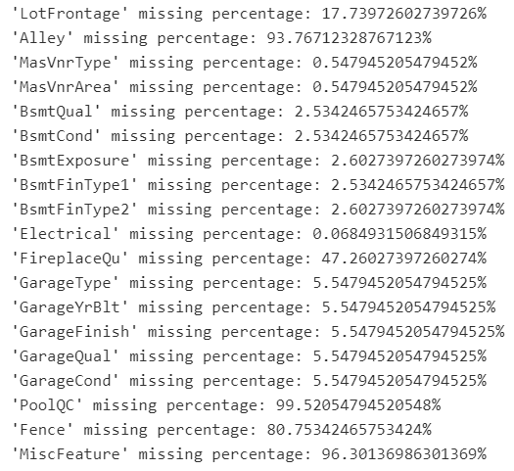
Missing values
Handled missing values as:
Deleted variables 'Alley', 'PoolQC', 'Fence', 'MiscFeature' since missing values > 80.
For Numerical Variables, we replaced it with mode value.
For Categorical Variables, we added ‘Missing’ label.

Slide 6
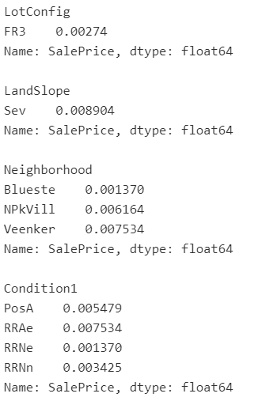
Rare Labels
For categorical variables, labels which are in less than 1% of data w.r.t target variable i.e. salesprice, add no values and thus, removed.

Slide 7
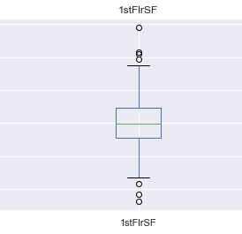
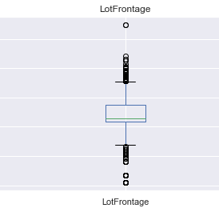
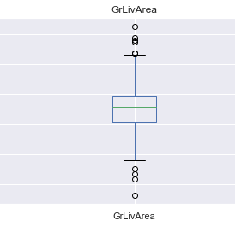
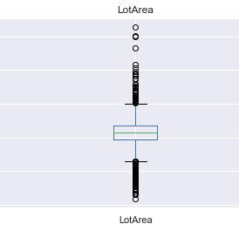
Outliers
We applied box plot to identify outliers in continuous variables.

Slide 8
Data analysis

Slide 9
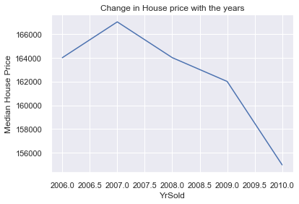
Observation 1: drop in value of houses
There has been a drop in the value of the houses. In real life scenario, such trend is a bit unusual as house prices generally go up as years go by.

Slide 10
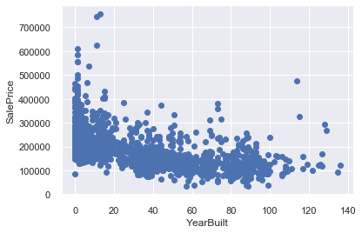
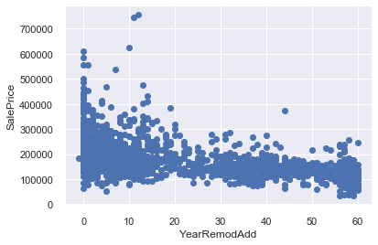
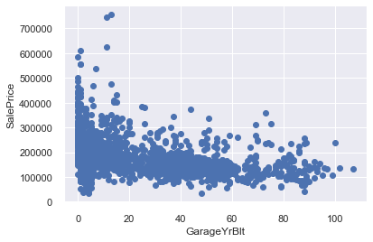
Observation 2: Decrease with Old
We observe a drop in prices as the features of the house get old. Ex, year in which the house was built.

Slide 11
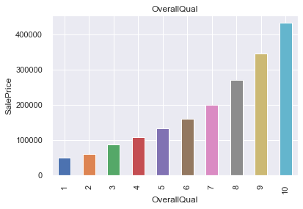
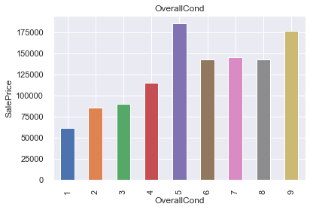
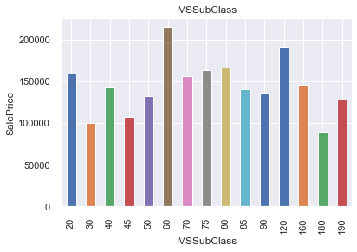
Observation 3: Discrete Variables non monotonic Relationship
We see that there is a relationship between the variable numbers and the SalePrice, but this relationship is not always monotonic. Only OveralQual is monotonic.

Slide 12
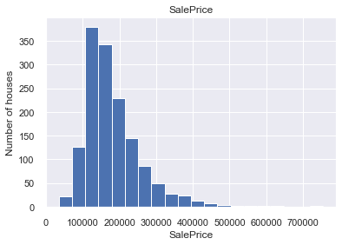
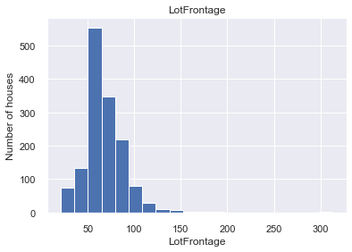
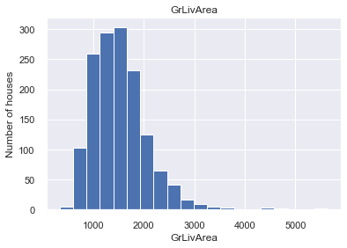
Observation 4: Continuous Variable not Normally Distributed
We see that all of the above variables, are not normally distributed, including the target variable 'SalePrice'. For linear models to perform best, we need to account for non-Gaussian distributions

Slide 13
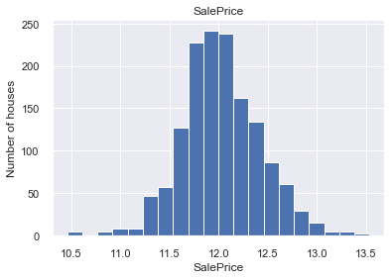
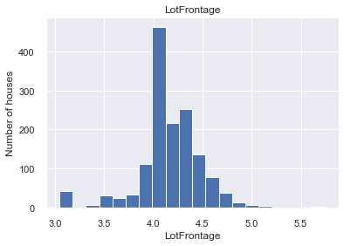
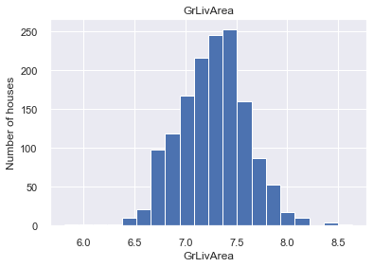
Observation 4: Continuous Variable noW GAUSSIAN Distributed
After applying log transformation, we achieved the gaussian distribution

Slide 14
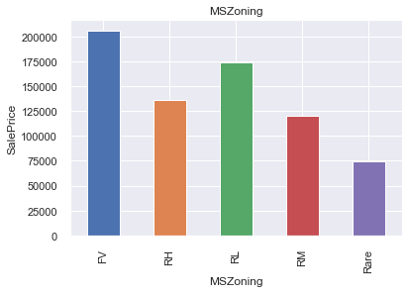
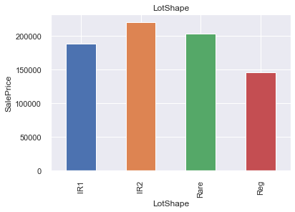
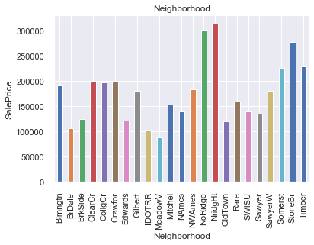
Observation 5: Categorical w.r.t Sales Price
As shown above, the categories give information on the SalePrice.

Slide 15
DatA Transformation

Slide 16
Data transformation
Following data transformation were done:
Year Data: We would transform the year data to fetch the difference between YrSold and others.
Numerical Data: We will log-transform the numerical variables that do not contain zeros in order to get a more Gaussian-like distribution.
Categorical Data: We will encode categorical variables here.

Slide 17
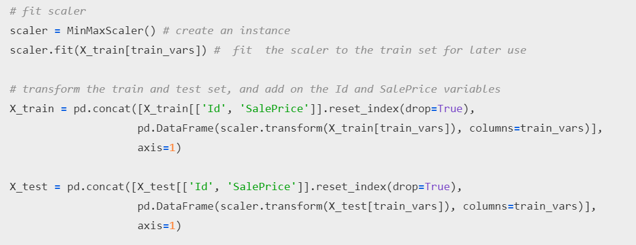
Feature scaling
For use in linear models, features need to be either scaled or normalised. We would scale features between the min and max values.

Slide 18
Feature selection
We would apply lasso regularization. This would make coefficient of many features zero, thus, reducing features used for prediction.
Result:
total features: 75
selected features: 21
features with coefficients shrank to zero: 54
Selected Features are: 'MSSubClass', 'MSZoning', 'Neighborhood', 'OverallQual', 'OverallCond','YearRemodAdd', 'RoofStyle', 'BsmtQual', 'BsmtExposure', 'HeatingQC', 'CentralAir', '1stFlrSF', 'GrLivArea', 'BsmtFullBath', 'KitchenQual', 'Fireplaces', 'FireplaceQu', 'GarageType', 'GarageFinish', 'GarageCars', 'PavedDrive'

Slide 19
Linear Regression (LASSO)

Slide 20
Lasso regression
Applied lasso regression, to predict sales price of house using the selected features in the previous slides.
TRAINING:
lin_model = Lasso(alpha=0.005, random_state=0) # remember to set the random_state / seed
lin_model.fit(X_train, y_train)
PREDICTION:
train_pred = lin_model.predict(X_train)

Slide 21
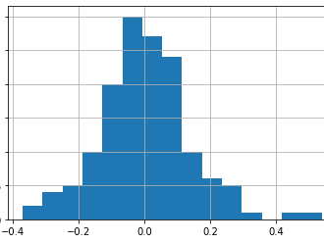
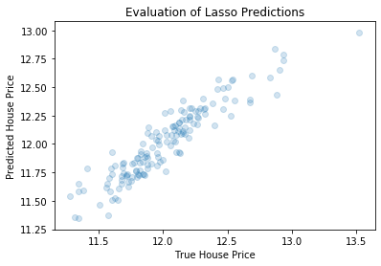
evaluation
Used mean squared and root mean squared error. Also, plotted the graph between true value vs predicted value and error graph.
In order to get the true performance of the Lasso, we need to transform both the target and the predictions back to the original house prices values.
linear train mse: 1087435415.4414542, linear train rmse: 32976.28565259366, linear test mse: 1405259552.2596064, linear test rmse: 37486.79170400698

Slide 22
Random Forest Regressor

Slide 23
Hyperparameter tuning
Before applying random forest, we used randomized search and grid search to identify best hyperparameters for Random Forest Regressor.
Result of Randomized Search: 'n_estimators': 800, 'min_samples_split': 2, 'min_samples_leaf': 1, 'max_features': 'sqrt', 'max_depth': 100, 'bootstrap': False
Using the above parameters, applied Grid Search CV.
Result: 'bootstrap': False, 'max_depth': 80, 'max_features': 'sqrt', 'min_samples_leaf': 1, 'min_samples_split': 5, 'n_estimators': 800

Slide 24
RANDOM FOREST REGRESSOR
Fetched the best estimator from Grid Search CV.
best_rfr = grid_search.best_estimator_
TRAINING:
best_rfr.fit(X_train, y_train)
PREDICTION:
ftest_pred = best_rfr.predict(X_test)

Slide 25
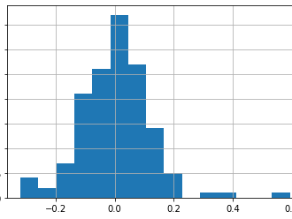
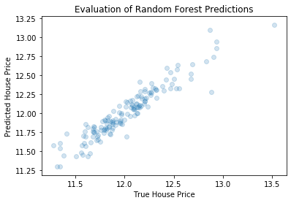
evaluation
Used mean squared and root mean squared error. Also, plotted the graph between true value vs predicted value and error graph.
In order to get the true performance of the Random Forest Regressor, we need to transform both the target and the predictions back to the original house prices values.
random forest train mse: 61737509.894433424
random forest train rmse: 7857.3220561736825
random forest test mse: 973651315.9107314
random forest test rmse: 31203.386289163096

Slide 26
Conclusions
Following conclusions can be drawn:
Both Lasso Regression and Random Forest Regressor produce good results.
Random Forest error was a little less than Lasso Regression.
Regression Algorithms applied successfully.

Slide 27
Thank you

